Slide 1
Fraud Detection and Target Marking for Bank Results
Megha Patel
CIS508-
Cohort B

Slide 2
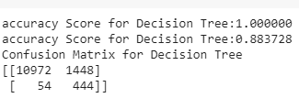
Fraud Detection Dataset
The target variable is to find out the number of cases where fraud was found or not.
Decision Tree Classifier:
So the default, accuracy score is:

Slide 3
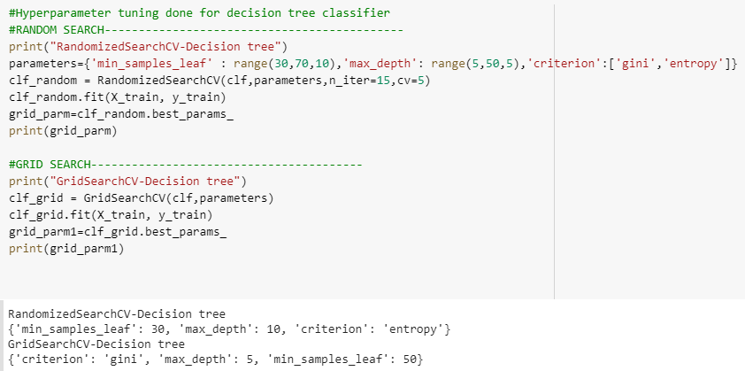
Parameter 1:
Hyperparameter tuning is choosing the set of optimal hyper-parameters to optimize the performance of the data.
Grid search performs searching exhaustively through a specified subset of hyperparameters while Random search performs searching on a specified subsets of data.
By passing a range of parameters, and performing a Random search and grid search we get the specified set of parameters.

Slide 4
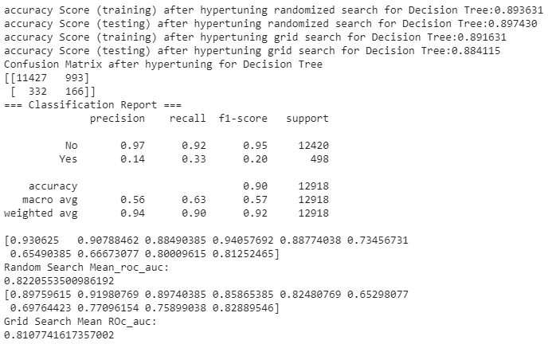
Parameter 1:
By passing the set of parameters obtained after hyper tuning to the decision tree classifier, we get the following data.
Here, the accuracy rate for both the train and test data for both the searches is almost similar.

Slide 5
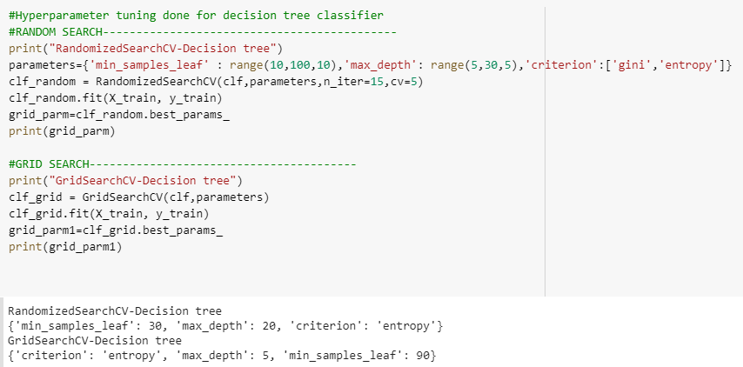
Parameter 2:
Specifying different set of range to the decision tree classifier, we get the following parameters for both the search.

Slide 6
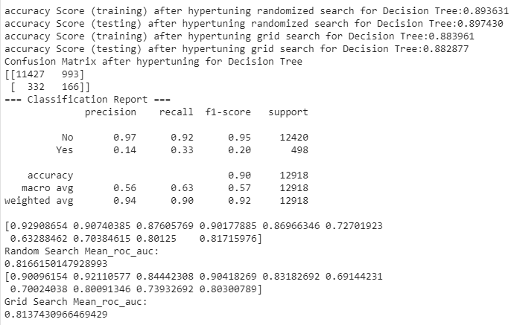
Parameter 2:
Here, we can observe that there is almost no change in the accuracy of both the train and the test data for both the searches in comparison with the above specified list of parameters.

Slide 7
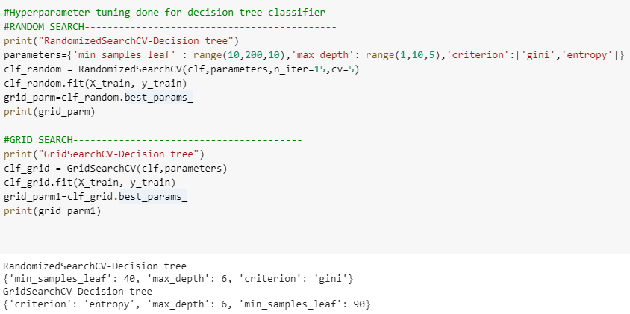
Parameter 3:
Repeating the same process again, with different set of range, we get the following parameters.

Slide 8
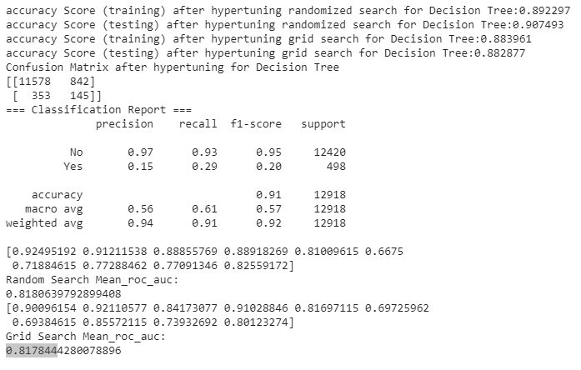
Parameter 3:
Hence, comparing all the values of all the 3 parameter range, we can say that there is no significant difference between the values in terms of either accuracy, precision or the recall rates.

Slide 9
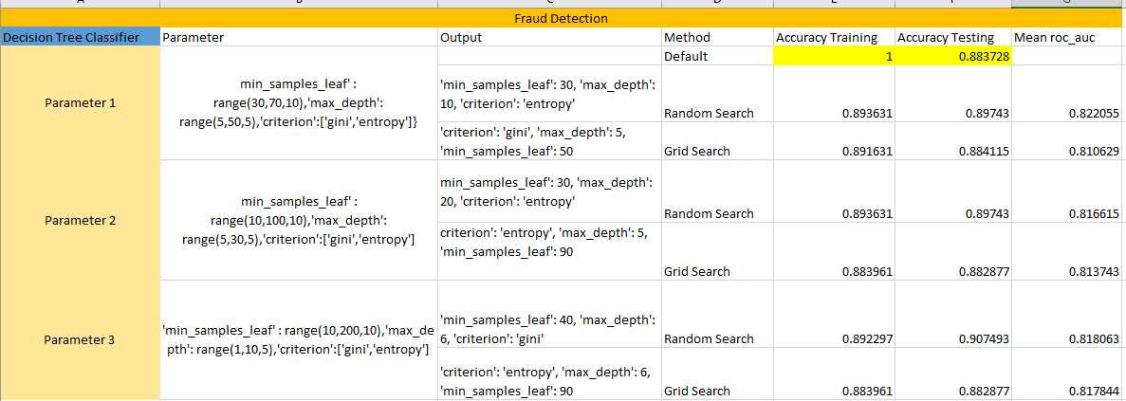
Excel Sheet Fraud Detection
Fair split

Slide 10
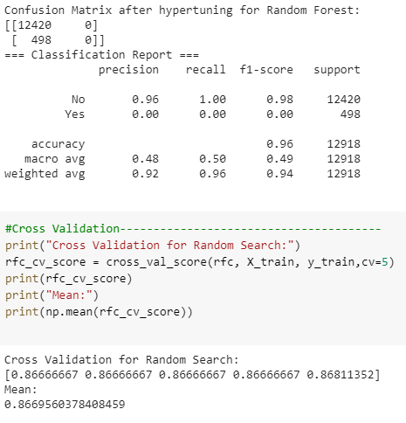
Random Forest-Parameter 1:
Here, in the randomized search of the random forest, we can see that the accuracy of the training data is 0.866956 while the accuracy of the test data is 0.961449.
This shows that there is a difference of almost 10%, thus this is the case of underfitting.

Slide 11
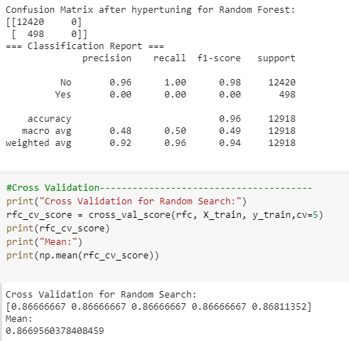
Parameter 2:
This case also has the same scenario compared to the ahead specified case. Here also, the data is underfitting as there is a difference of almost 9% in the accuracy rate of training and testing data.

Slide 12
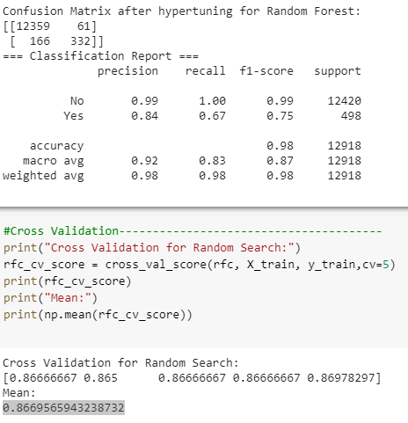
Parameter 3:
Here, there is not much difference between the accuracy rates of the training and test data. So this can be considered as a good parameter range among all the 3 parameter ranges.

Slide 13
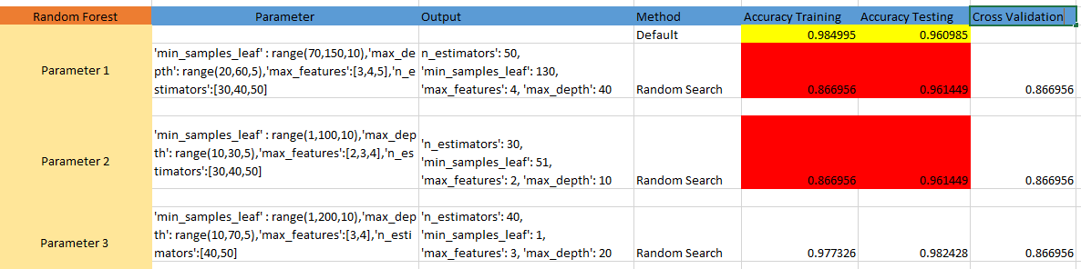
Excel Sheet Fraud Detection
Cases of Underfitting.

Slide 14

Direct Marketing
The target variable is to find out weather the client has subscribed for a term deposit or not?
Decision Tree Classifier:
Default Accuracy Score:

Slide 15
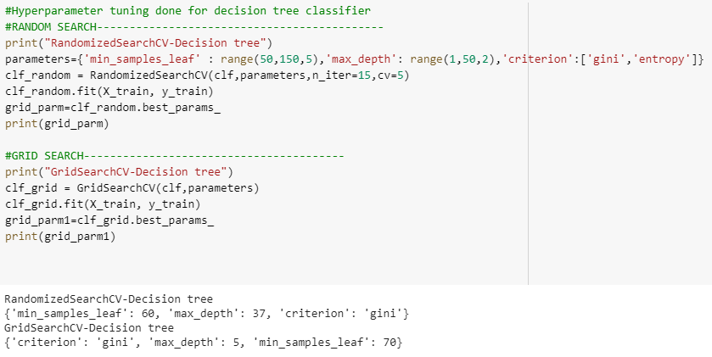
Parameter 1:
Considering the parameter ranges as 50 to 100 with 5 interval range for min_sample_leaf , max depth as 1-50 with interval of 2 and passing criterion as gini and entropy to find the impurity in the data and to gain information and passing this values to both the search we get the following set as best set of parameters.

Slide 16
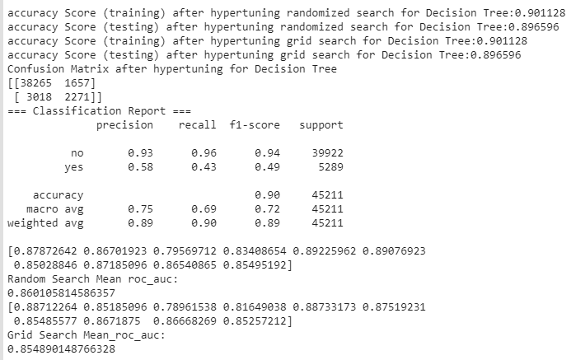
Parameter 1:
From this data, we can see the accuracy rates of both the train and test data which is almost the same for both the searches.
Also, the mean of roc_auc is nearly 86% which means that the data is split fairly.

Slide 17
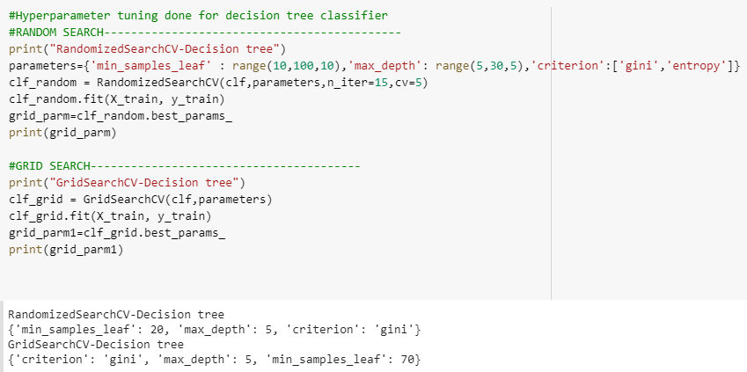
Parameter 2:
Repeating the same process, for parameter 2 and parameter 3 we get the following outputs.

Slide 18
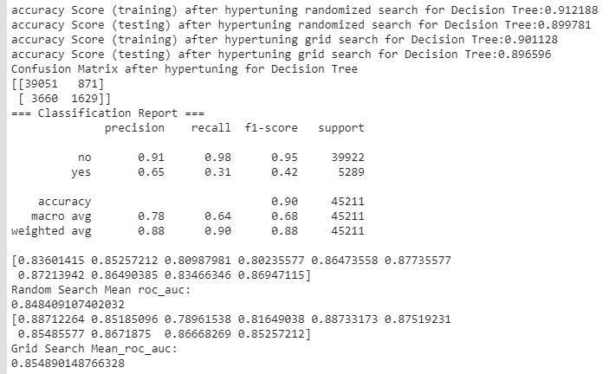
Parameter 2:

Slide 19
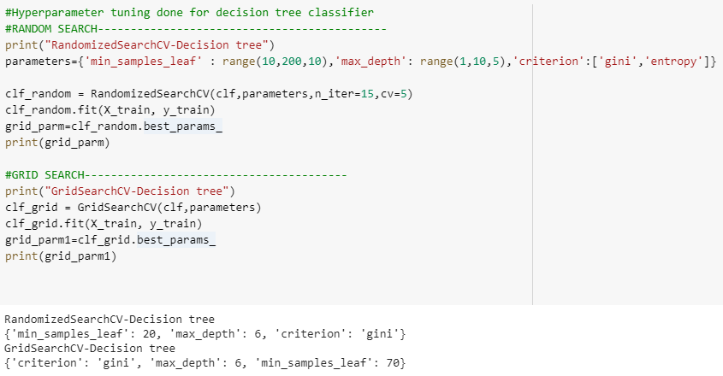
Parameter 3:

Slide 20
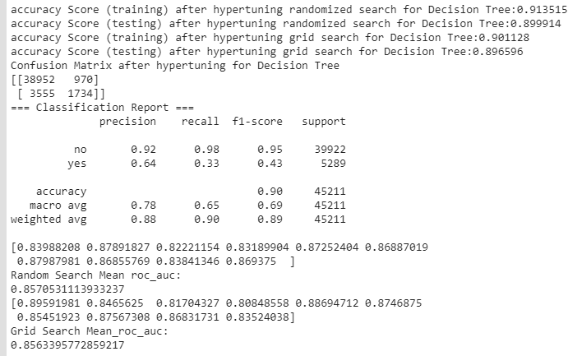
Parameter 3:
Thus, we can conclude that there is no big change in the results even after computing different set if ranges to the parameters.
Hence, we can select the default accuracy as the best.

Slide 21
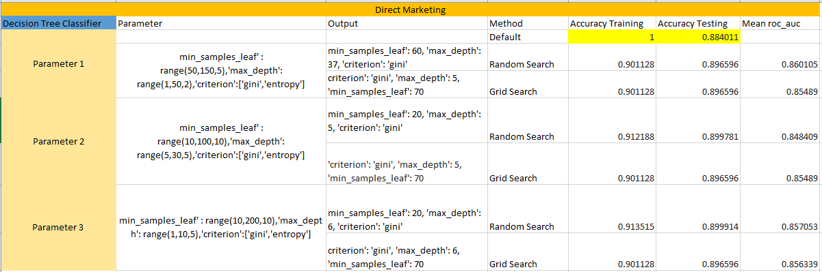
Excel Sheet Direct Marketing
Fair split

Slide 22
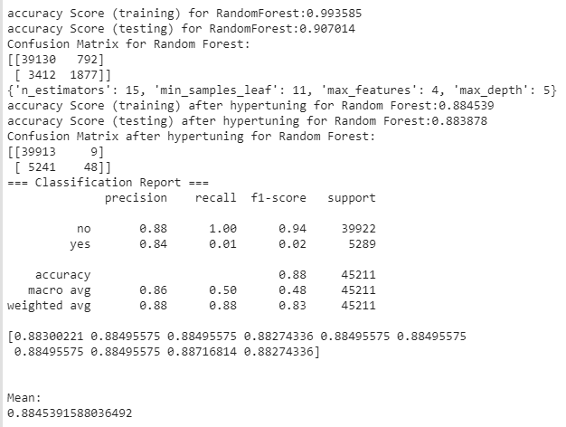
Random Forest:
Parameter 1:
Out of all the positive classes, how much data we predicted correctly.

Slide 23
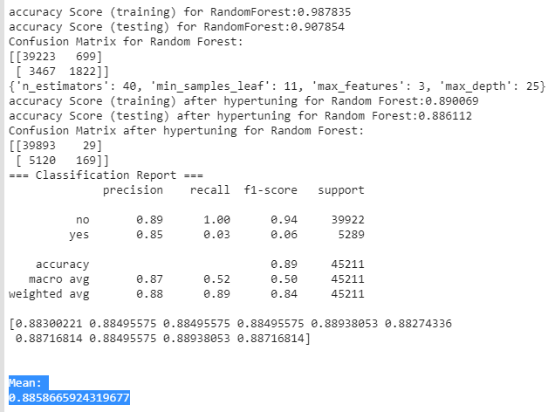
Parameter 2:
Out of all the positive classes, how much data we predicted correctly.
Although it is good to have the value as 1, but this cannot be the ideal case.

Slide 24
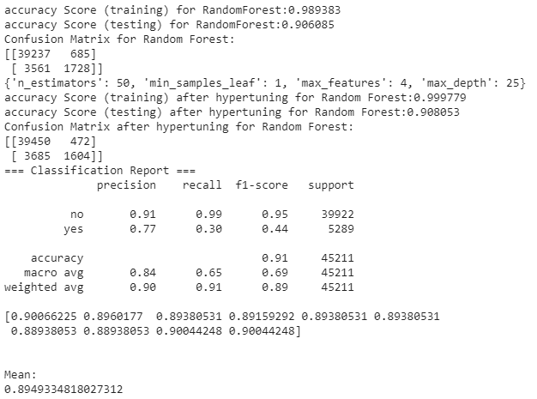
Parameter 3:
This is the case of overfitting of data as the accuracy of training data is almost 9% more than the accuracy of the test data.

Slide 25
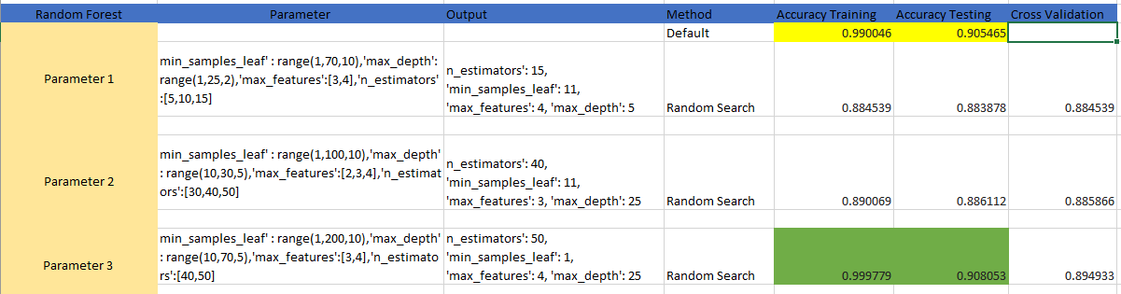
Excel Sheet Direct Marketing
This is the case of overfitting of data as the accuracy of training data is almost 9% more than the accuracy of the test data.

Slide 26
Summary
Thus, in the assignment 1 we were simply generating a single decision tree with the help of decision tree classifier and were considering the accuracy of the data to be ideal.
While, in this assignment we found out the best set if parameters with the help of hyperparameter tuning and performed two type of searches.
1)The grid search which took into consideration the exhaustive subsets of hyper-parameterized data.
2)Random Search only performed search on the specified subsets of data.
With the help of the cross-validation we were able to find out how the data fitted. If the training and testing accuracy score are same than the data does not fit properly.

Slide 27
Thankyou

